Slide 1
Android

Slide 2
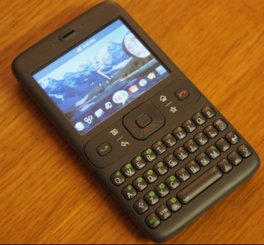
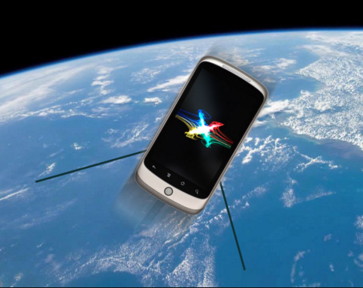



Interesting facts
ANDROID
1.0 1.1

Slide 3
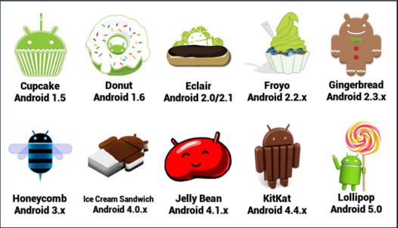


Versions

Slide 4
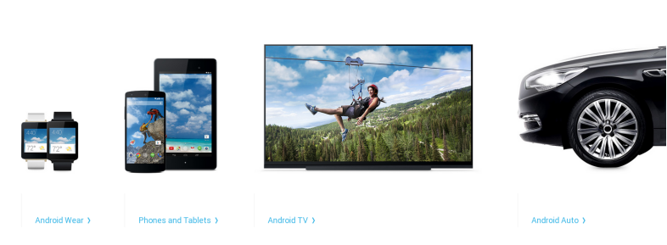

Slide 5
Main components of Android:
Activity
Services
Broadcast receivers
Content Providers

Slide 6
Activity
An activity represents a single screen with a user interface

Slide 7
Services
A service is a component that runs in the background to perform long-running operations or to perform work for remote processes.
Example : It might fetch data over the network without blocking user interaction with an activity.

Slide 8
Broadcast receivers
A broadcast receiver is a component that responds to system-wide broadcast announcements.
They are also responsible for displaying the notification in the notification bar.
Example, a broadcast announcing that the screen has turned off, the battery is low, or a picture was captured.

Slide 9
Content Providers
A content provider manages a shared set of app data.
Data for a app is stored in file system, an SQLite database.
Through the content provider, other apps can query or even modify the data.
For example, the Android system provides a content provider that manages the user's contact information.

Slide 10
First Application

Slide 11
Android Studio Project Structure

Slide 12
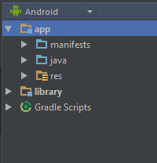
Android View
Android project view (Default)
Shows the most important source directories at the top level of the module hierarchy.
Groups the build files for all modules in a common folder.
Groups all the manifest files for each module in a common folder.
This view shows a flattened version of your project's structure that provides quick access to the key source files of Android projects

Slide 13
Manifest File:
Every application must have Manifest.xml file in the root directory.
It acts like an interface between Android OS and the application providing the essential information.
Some of the main things it declares is:
Minimum API level for the application.
The components like the activity, services, broadcast receivers.
Required permissions

Slide 14
Manifest file structure
<?xml version="1.0" encoding="utf-8"?> <manifest> <uses-permission /> <permission /> <uses-sdk /> <uses-configuration /> <uses-feature /> <application> <activity> <intent-filter> </intent-filter> <meta-data /> </activity> <service> <intent-filter> . . . </intent-filter> <meta-data/> </service> <receiver> <intent-filter> . . . </intent-filter> <meta-data /> </receiver> <provider> </provider> </application> </manifest>

Slide 15
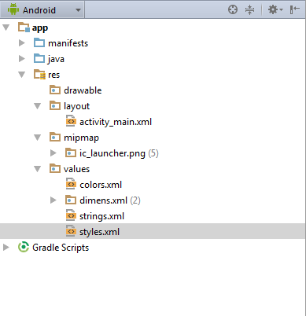
Res folder
Contains the UI components of the application.
Drawable folder: Add custom drawable xml files and any images.
Layout folder: Contains the layout files shown in activity, dialog box
Mipmap: Put the application icon and images in mipmap. The advantage of keeping images in mipmap is that the images are not compressed as per the screen resolution.
Values: All the string contents, colors with their hexadecimal values can be kept in this folder instead of hardcoding in the code.

Slide 16
Gradle Build
The build system automatically takes all the source files (.java or .xml),
then applies the appropriate tool(e.g, takes java class files and converts to dex format)
and groups all of them into one compressed file, apk
Now, in order to automate all these tasks, there has to be a script; you can write your own
build system using shell scripting in linux or batch files syntax in windows.
Same Google wrote Android plugin for gradle using Groovy syntax.

Slide 17
Gradle scripts
Android project contains a top level build file and a build for each
module in build.gradle file.
apply plugin: 'com.android.application'
applies the Android plugin for Gradle to this build.
We can define the dependencies on some external libraries in the file.
The build system adds all the compile dependencies to the
compilation classpath and includes them in the final package
More information can be found at
http://developer.android.com/tools/building/configuring-gradle.html

Slide 18
Activity
Step 1: Create a subclass of Activity.
Step 2: Declare it in the manifest file
<manifest ... > <application ... > <activity android:name=".ExampleActivity" /> <intent-filter> <action android:name="android.intent.action.MAIN" /> <category android:name="android.intent.category.LAUNCHER" /> </intent-filter> </application ... > ... </manifest >
The intent filter declares how other components will activate it

Slide 19
Step 3: Define the layout of the activity
ViewGroup and View components.
Step 4: In the main activity class override the onCreate method and
pass the layout file name in setContentView method.
Step 5: Initialize the view components.
findViewById method.

Slide 20
Calling Another Activity
Intent: An intent is a messaging object used to pass data between activities and between activity and service or to deliver a broadcast.
Intent specifies the activity to start and carries any necessary data.
There are two types of intents:
1. Explicit Intent: The components to start are specified by name. It is used to start the activity within same application.
2. Implicit Intent: Do not name the specific component but instead declare a general action to perform, so that we can trigger components from different applications.

Slide 21
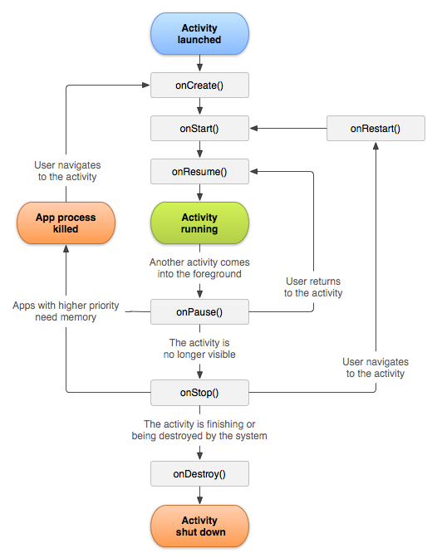
Activity Lifecycle

